Slide 1
Helicopter
Tom Dale Davis Mariotti Andrew Peacock

Slide 2
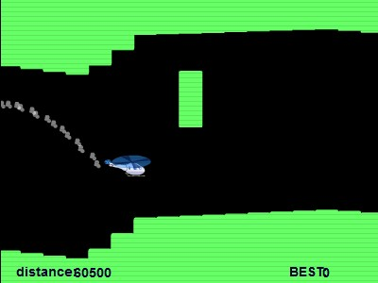
Helicopter Game basics
Using VHDL and the NEXYS 4 DDR we wanted to make a functioning helicopter game
Rules:
Press button to fly up
Don’t crash into walls

Slide 3
Goals
"0011110000000000001111",
"00000011110000011110000",
"00000000001111100000000",
"00000000000010000000000",
"00000000000010000000000",
"00000000001111111100000",
"10100000011000010011000",
"01011111100111010001100",
"10100001000101010000100",
"00000001000111011111110",
"00000001000000000000010",
"00000000100000000000010",
"00000000011111111111100",
"00000000000010000100000",
"00000000000010000100000",
"00000000111111111111110"
1: Make helicopter on screen
2: Make heli go up and down with button click
3: Create simulated gravity
4: Add simple scrolling walls
5: Create pause button.
5: Implement collisions between helicopter and walls
6: Create randomized wall patterns
7: Add score counter
8: Include game over screen

Slide 4
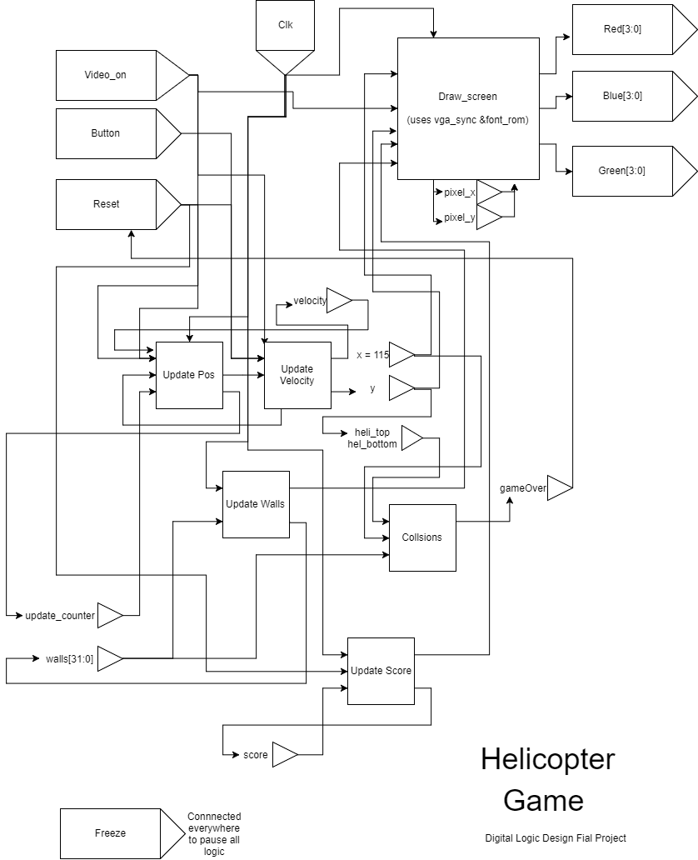
Logic

Slide 5
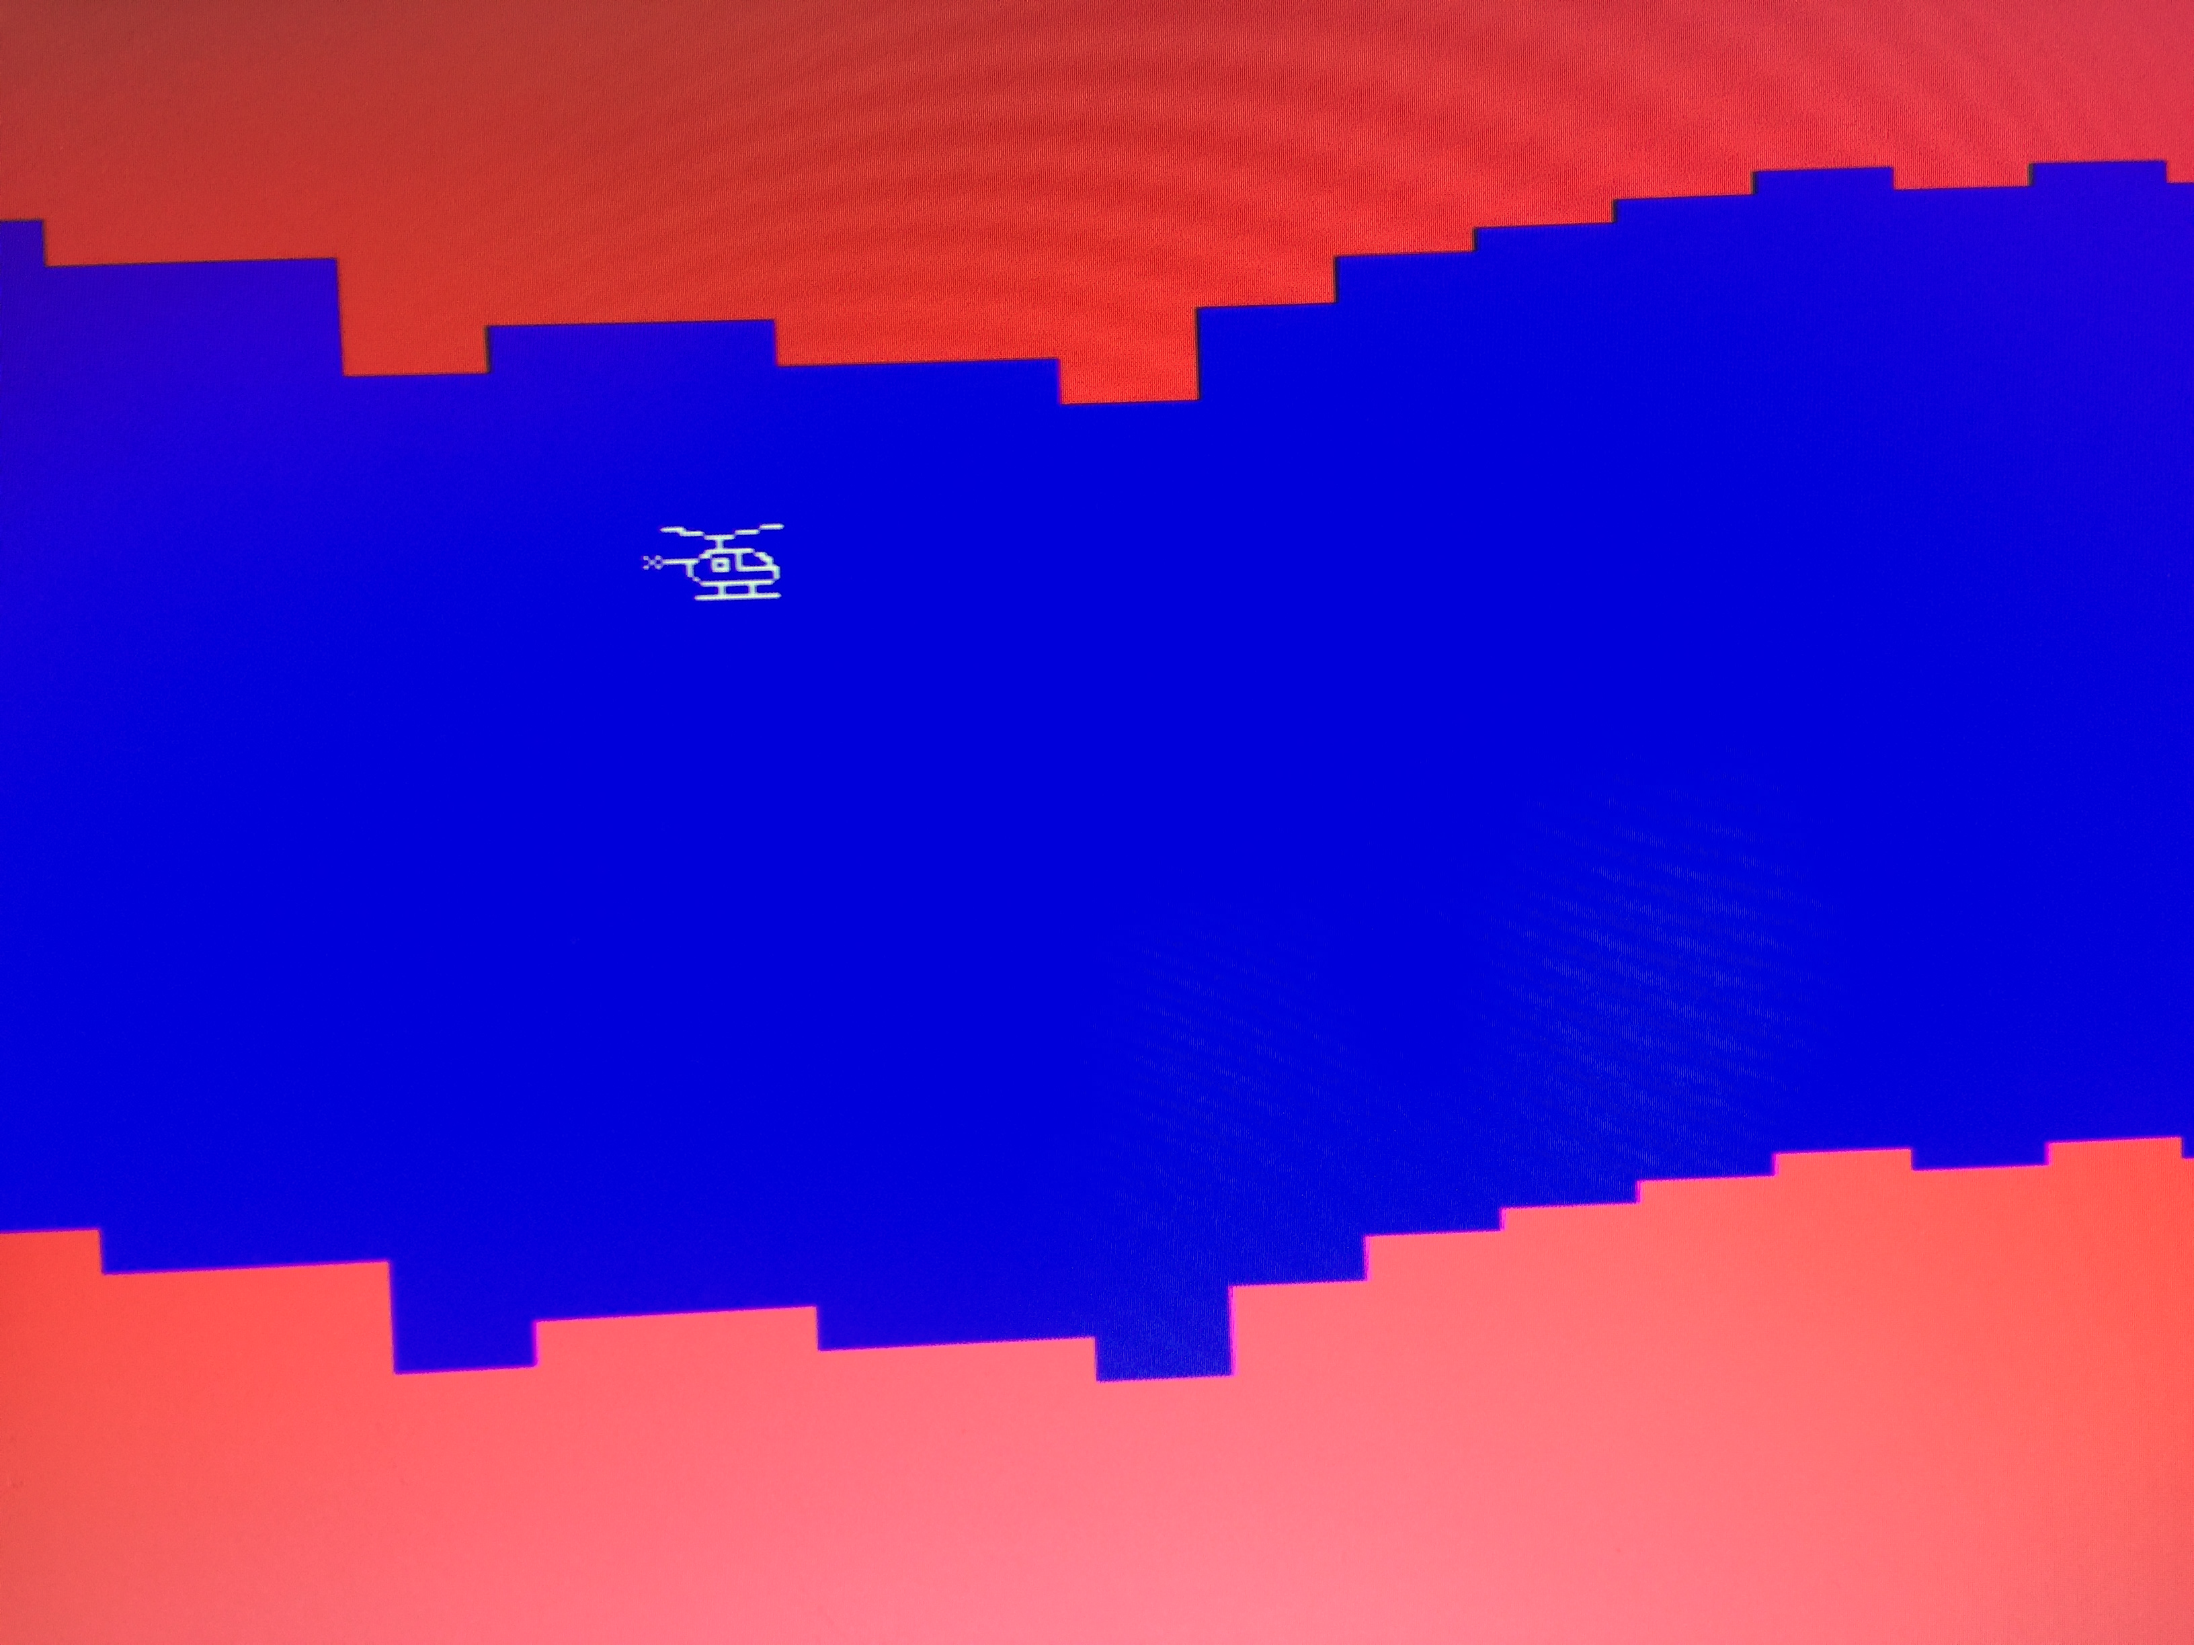
demo

